Slide 1
BASIC Speech representations and features
COMP.SGN.120 Introduction to Audio and Speech Processing
28.11.2023

Slide 2
Topics of the lecture
Speech as a physical and digital signal
General signal properties & short-term analysis
Basic time-domain speech features
Frequency-domain representations:
Time-frequency representation of speech
Speech and noise

Slide 3
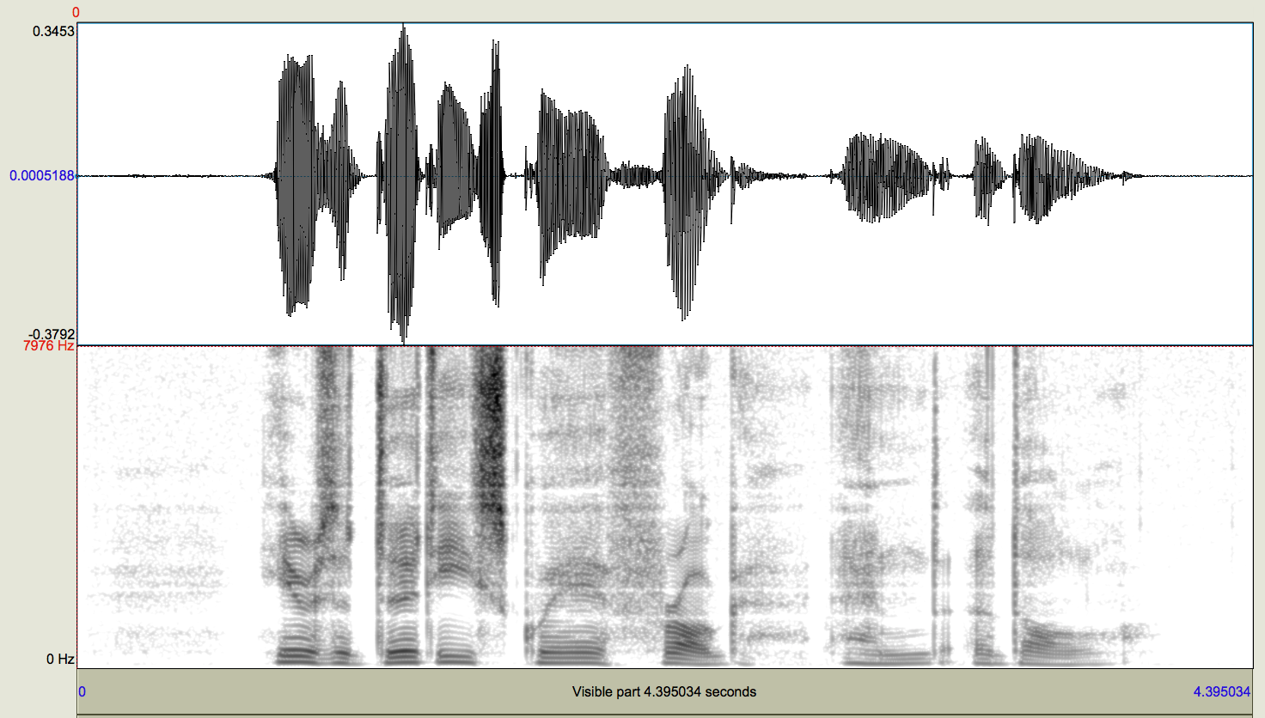
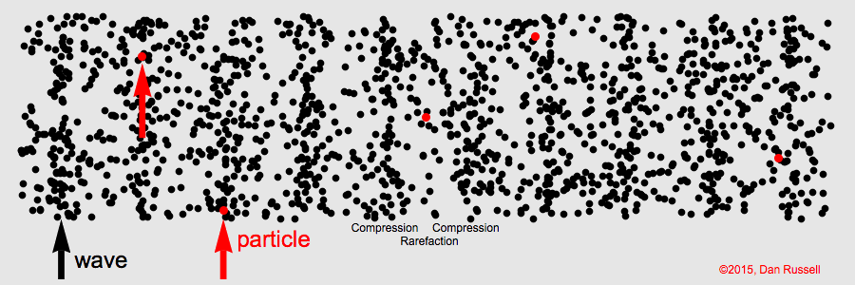
Speech as a physical signal
Speech waveform is an acoustic signal (as other audio on this course).
Air pressure variation p(t) as a function of time (compared to static air pressure).
Convention: 0 dB SPL = 20µPa.
A waveform of an English utterance.
Visualization of a planar acoustic wave

Slide 4




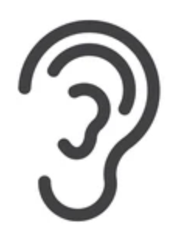
Speech as a physical signal
In the general case:
Produced by different speakers in different contexts for various types of everyday communication needs.
Mixed with other sounds in the environment (additivity of sources)
Propagates through a channel (which can be time-invariant or time-dependent).
Is captured by different ears or microphones.
Typical research data:
Controlled speech tasks.
Controlled, low-noise or even anechoic recording environments.
Fixed and high-quality recording equipment.

Slide 5
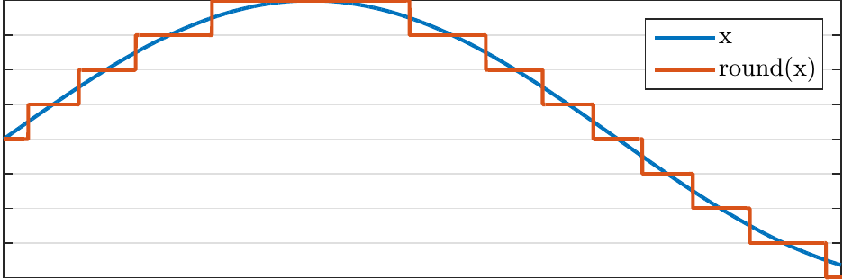
Speech as a digital signal
Speech is captured by a microphone and digitized for processing.
samples x[n] = discrete amplitude values x at discrete time-steps n
E.g., 44 100 kHz sampling rate at 16 bits per sample (“CD audio quality”)
Basic: linear pulse code modulation (LPCM; e.g., CDs and .wav files).
16 bits = 2¹⁶ amplitude levels = 20log₁₀(2¹⁶) ≈ 96dB dynamic range.
Can also be compressed / companded in various ways (e.g., in VoIP, mp3).
A waveform of an English utterance.
Linearly quantized waveform (zoomed in)

Slide 6
Speech as a digital signal: sampling rate
Nyquist theorem: sampling rate f_{s} ≥ 2B , where B = signal bandwidth of interest.
Some typical frequency bands of speech audio:
Landline telephone or narrowband GSM/VoIP: 300–3 400 Hz (analog or digital at f_{s} = 8000 Hz)
Wideband GSM/VoIP: 50–7 000 Hz (f_{s} = 16 000 Hz)
CD-audio: 0–22 050 Hz (theoretical; f_{s} = 44 100 Hz)
Typical speech processing applications use 0–8000 Hz (f_{s} = 16 000 Hz), as most speech phenomena occur between 70 and 8 000 Hz:
Fundamental frequencies 70–500 Hz (vocal fold vibration)
Key acoustic resonances 300–3400 Hz (“formants” of vowels and other sonorants)
Turbulent noises 3000–8000 Hz (fricatives).

Slide 7
Speech as a digital signal
Why bit-depth and sampling rate (together: bitrate) matter?
Too low bit-rate:
Transmission & synthesis: poor intelligibility and poor sound quality.
Analysis: less information in the signal → worse performance.
Too high bit-rate:
Transmission: consumes extra bits (out of limited bandwidth)
Storage: takes more space than necessary
Analysis: contains redundant/unnecessary information, high-frequencies can contain less reliable information
All tasks: requires more computation (battery/other electricity, time, limited hardware)
= extra computation and storage costs money and takes more time to process
Guideline: Use signal format that is sufficiently detailed but nothing more (default: f_{s} = 16 kHz).

Slide 8
General properties of speech signals

Slide 9
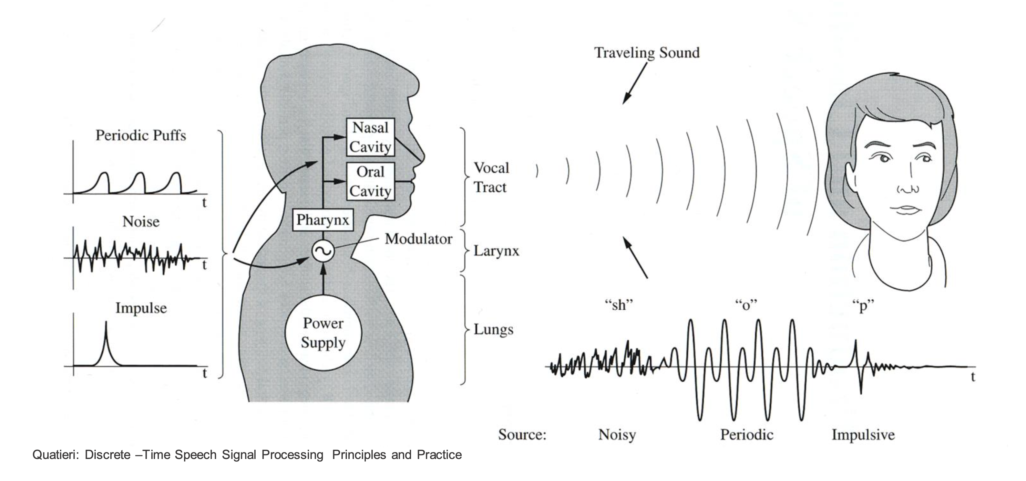
Ingredients of speech signals
Three basic ingredients:
different types of noises (turbulence)
different types of impulsive bursts (sudden releases of air)
periodic vibrations
+ periods of silence

Slide 10
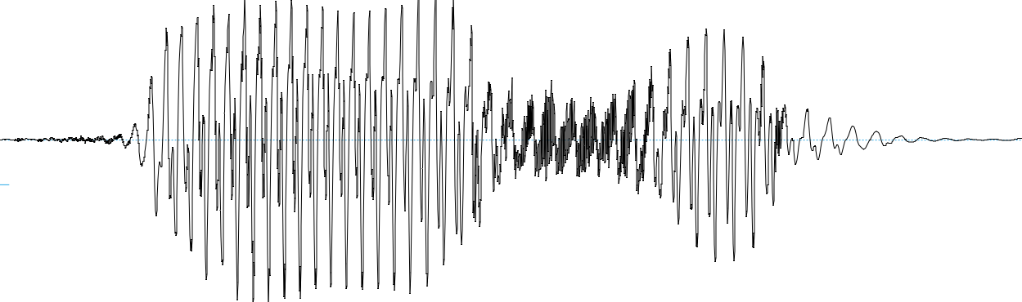
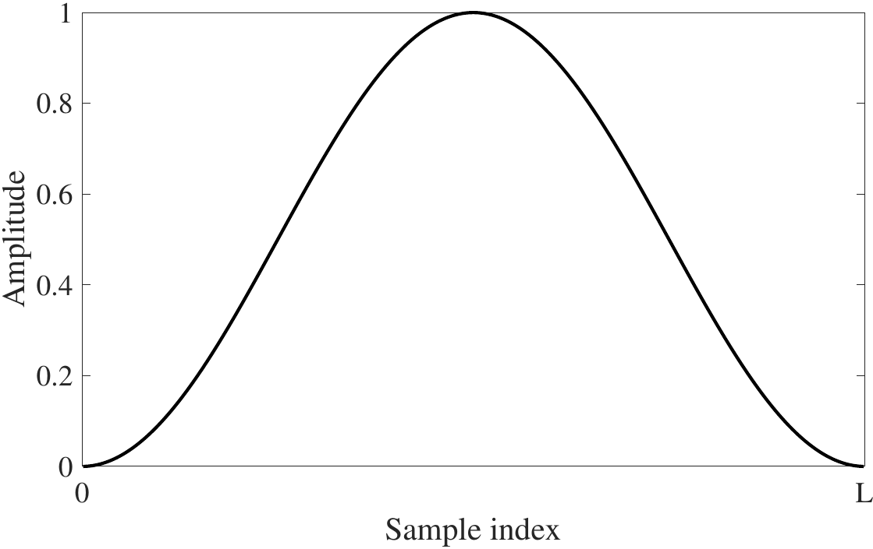
Windowing
Speech signals x[n] can be considered as quasi-stationary on short time-scales.
Windowing: controlled selection of a signal segment
y_{k}[n]=x[n-k]w[n]
Common window functions: Hann, Hamming, square…
Non-square functions shape spectral leakage caused by finite window and finite sampling rate.
Figure 4: Hann-window

Slide 11
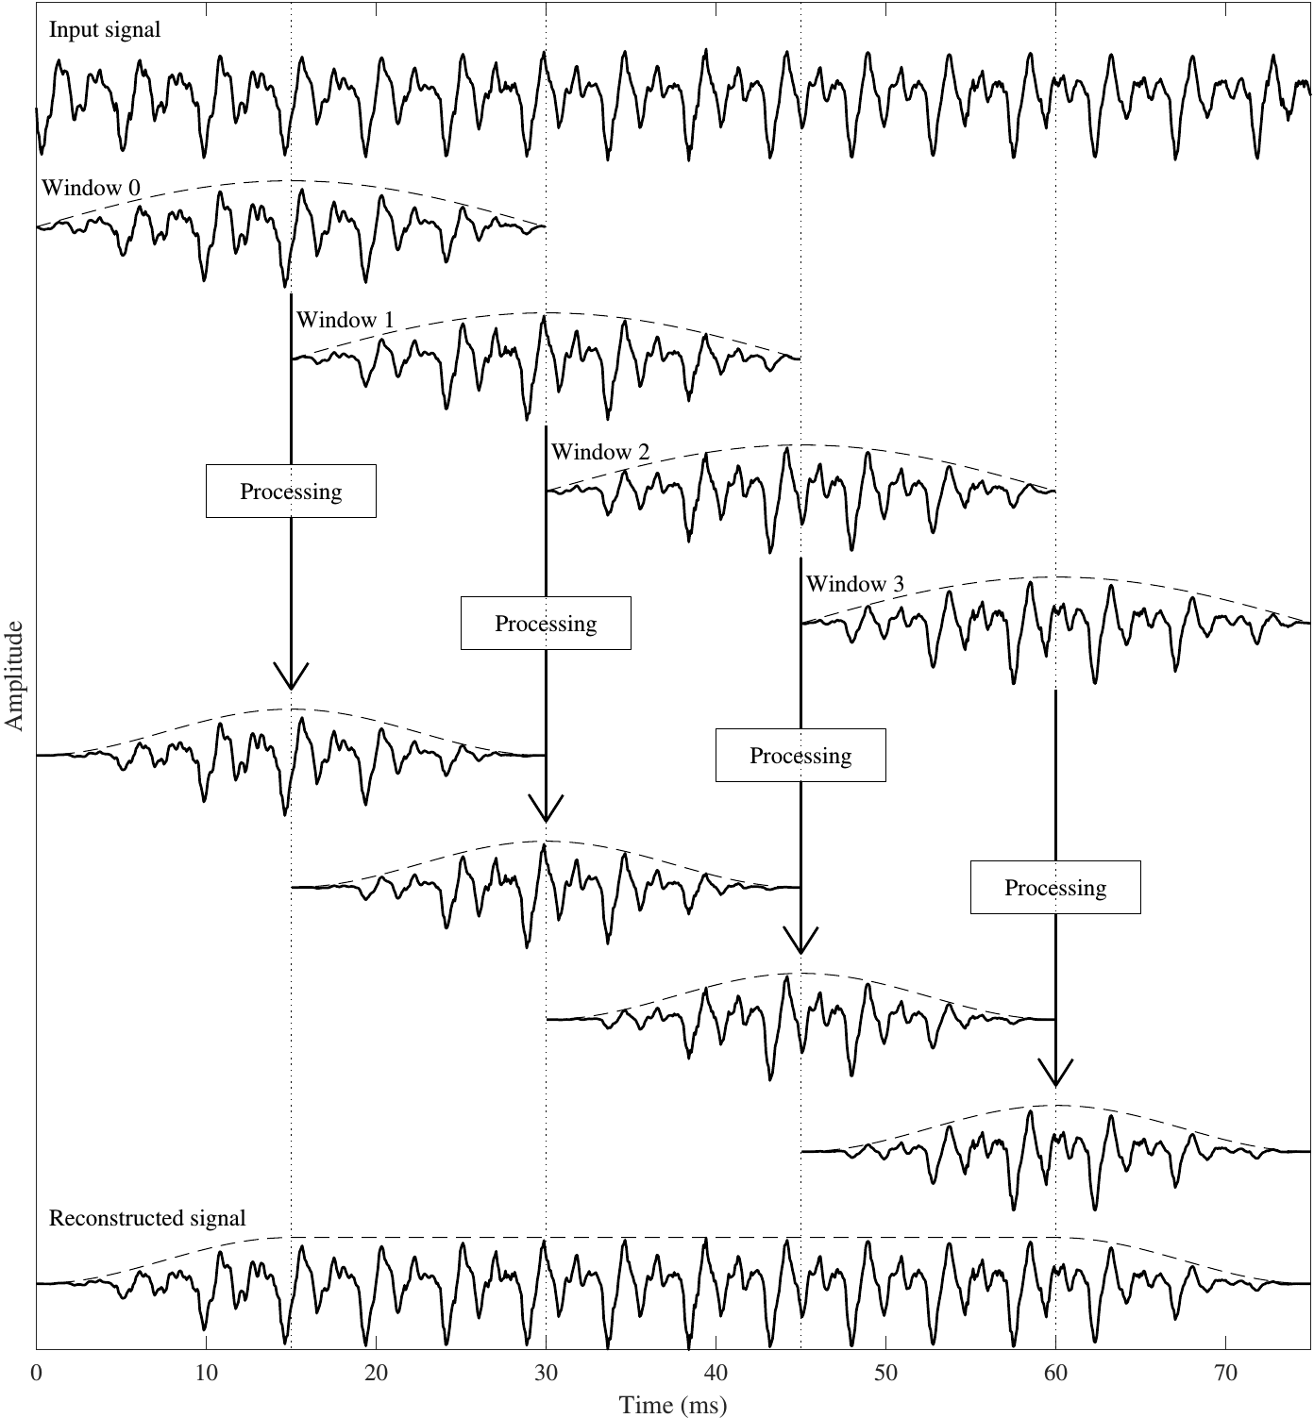
Windowing
Windowing is usually applied in a sliding manner with 50% overlap.
Proper window function and overlap allows lossless signal reconstruction.
(you can verify this with pen and paper if you want)

Slide 12
Time-frequency analysis of speech: practical considerations
Window length:
Basic constraints: DFT assumes a stationary signal.
Speech is only quasi-stationary: problems with changing contents.
Window must span at least one F0 period to capture structure.
Longer windows = higher frequency resolution in DFT.
Shorter windows = higher temporal resolution.
Short-term analysis is a trade-off between temporal resolution and frequency resolution.
Typically 20–30 ms windows with steps of 10 ms.

Slide 13
Some basic time-domain features of speech

Slide 14
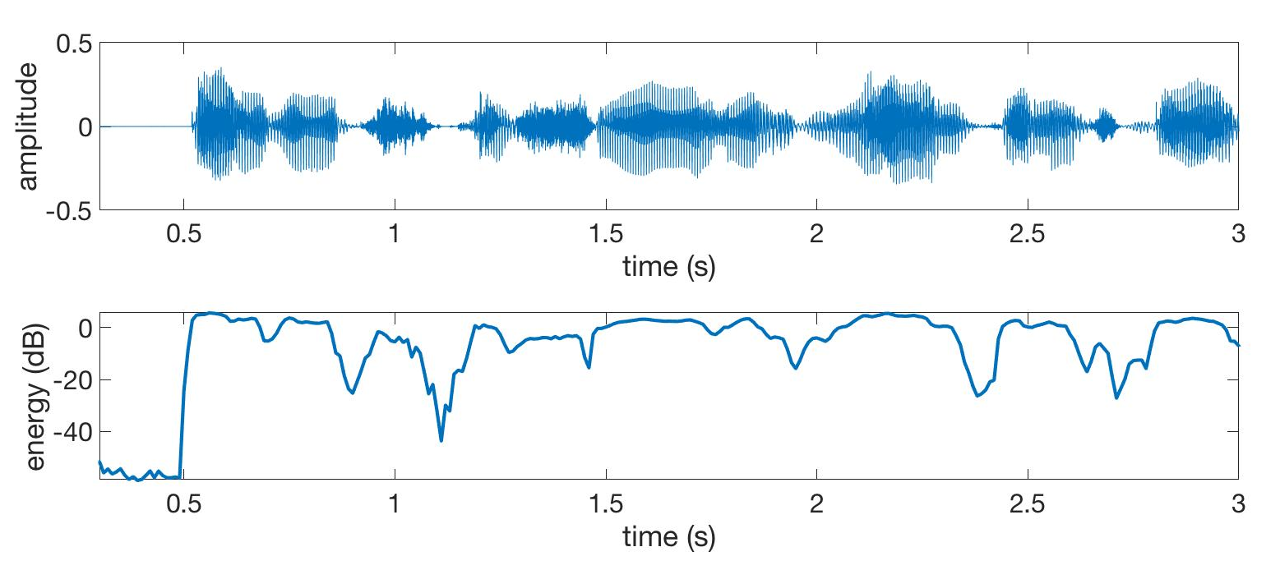
Time-domain analysis: energy
Energy representations:
Sample energy E[n] = x[n]² (not very useful: why?)
Window energy E_{k} = sum(y [n]²) , or y^{T}y
Log-energy scales more nicely: E_{log,k} = 10log₁₀(E_{k})
Energy useful for speech activity detection. Also useful auxiliary feature for many other tasks.
Limitations: absolute energy not meaningful.
Normal speech recordings are not calibrated (e.g., distance from mic changes E).
Changes in log-energy still informative.
Notes:
Some useful characteristics of the signal can be derived from the (windowed) waveform.

Slide 15
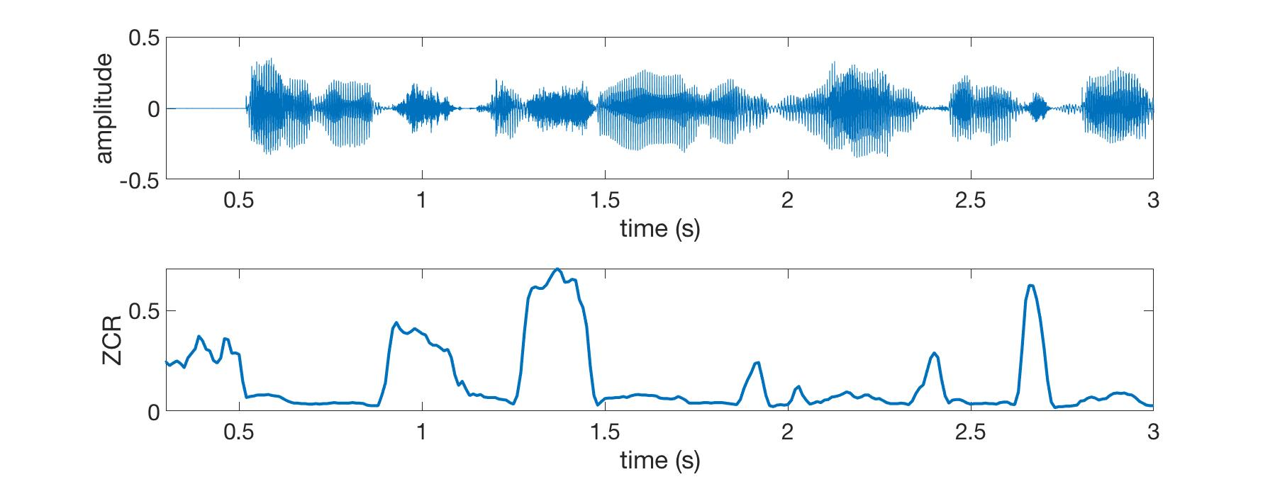
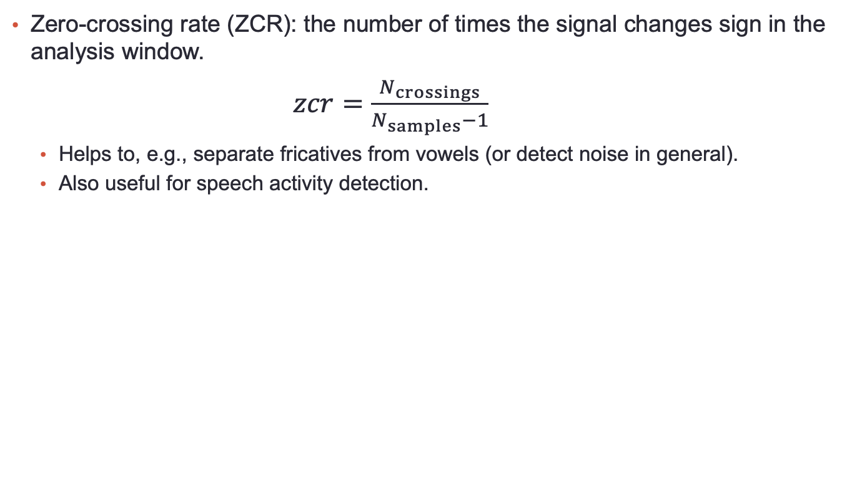
Time-domain analysis: ZCR
Zero-crossing rate (ZCR): the number of times the signal changes sign in the analysis window.
$zcr=\frac{N_{crossings}}{N_{samples}−1}$
Helps to, e.g., separate fricatives from vowels (or detect noise in general).
Also useful for speech activity detection.
“By which, a soul is drawn from it’s body”

Slide 16
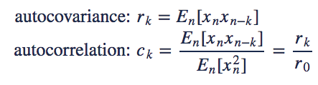
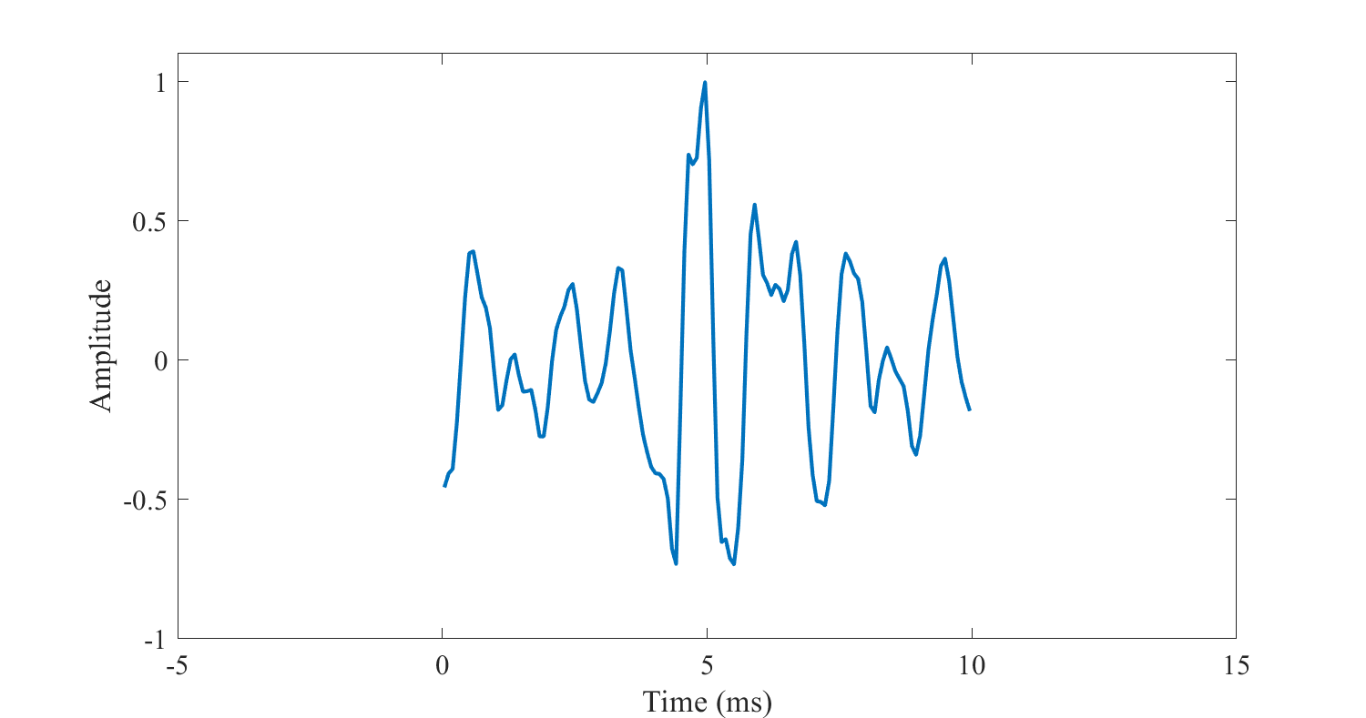
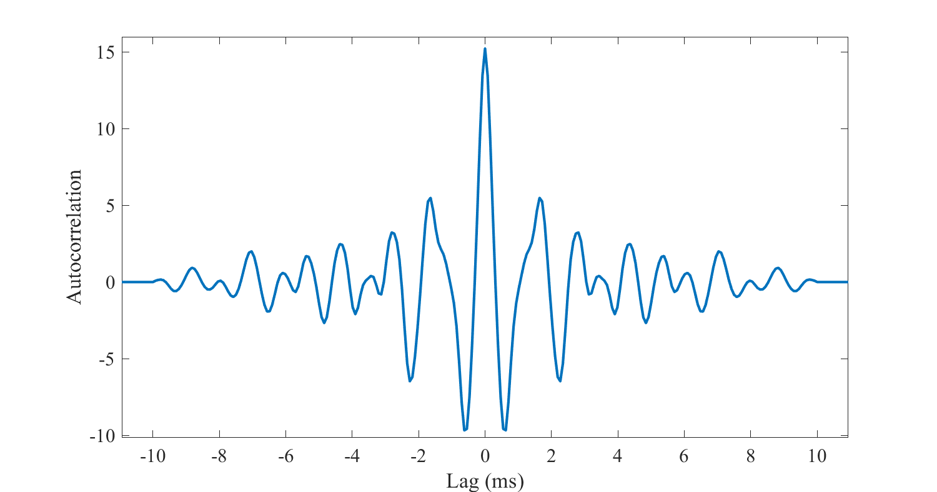
Time-domain analysis: autocorrelation
Autocovariance and autocorrelation: a measure of periodicity
Intuitively: how similar is the signal with itself at different delays (e.g., does it repeat itself?)
Often autocovariance is also rerred to as ”unnormalized” autocorrelation.
Windowed signal
Autocovariance of the window
Notes:
s

Slide 17
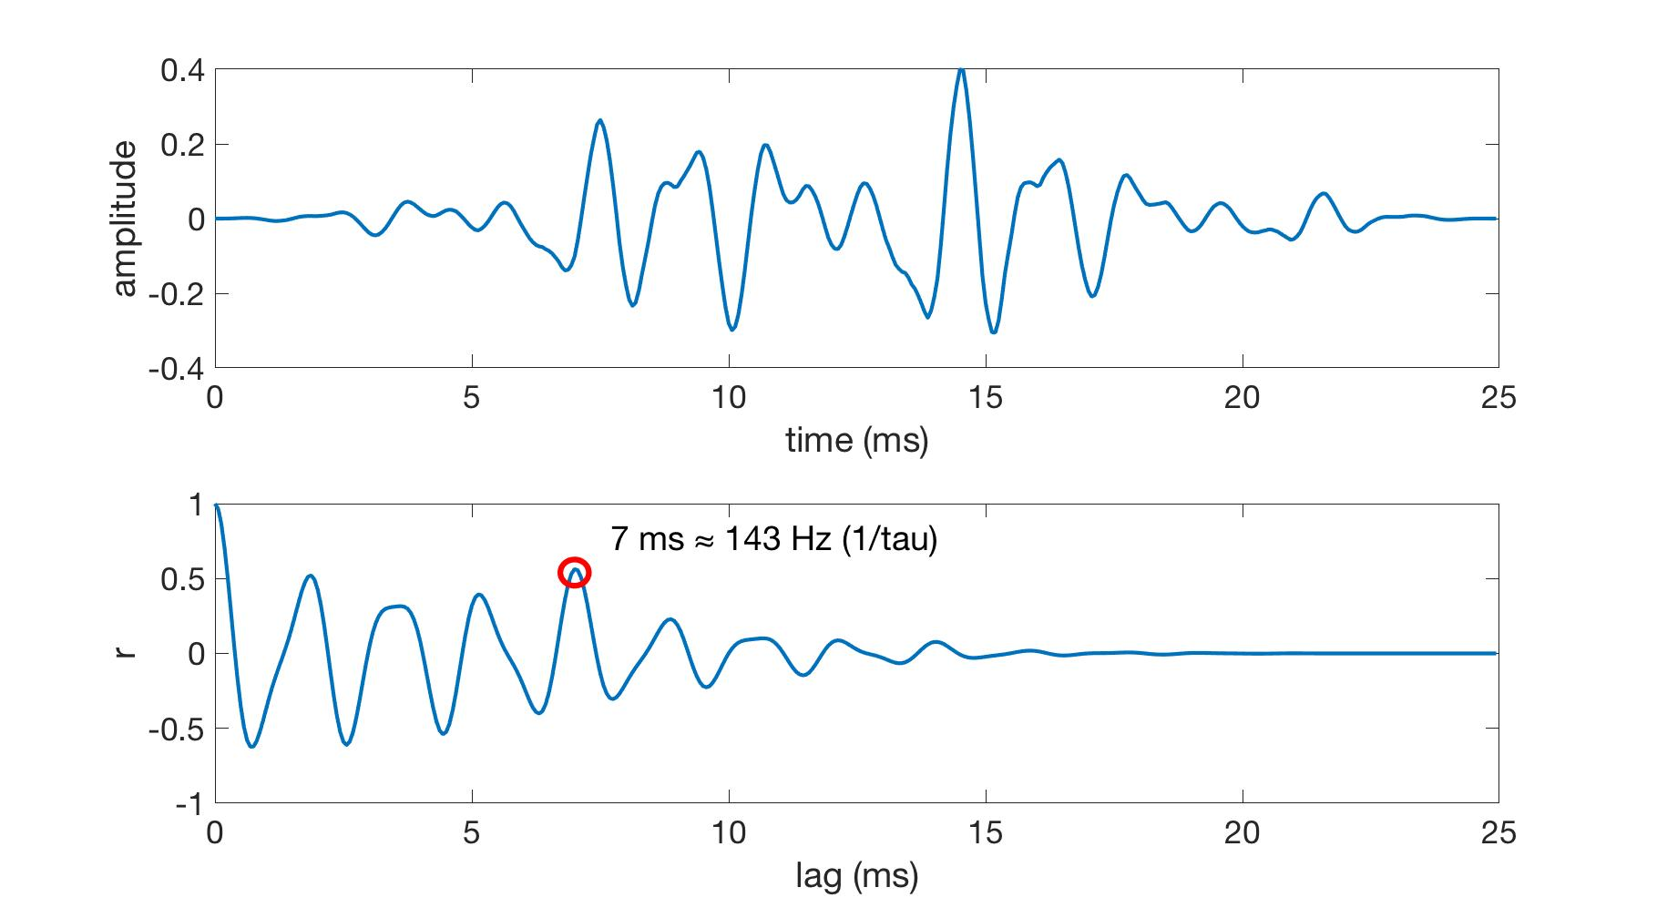
Time-domain analysis: autocorrelation
Example use of autocorrelation: fundamental frequency (F0) detection.
Top: a windowed speech waveform of a voiced sound. Bottom: autocorrelation of the waveform.

Slide 18
Time-domain analysis: autocorrelation
Q1: What would autocorrelation of an infinitely long sinusoid signal look like?
Q2: Finite-length windowed sinusoid?
Q3: How about autocorrelation of an impulse train (windowed / infinite)?
Q4: White Gaussian noise (windowed/infinite)?

Slide 19
Basic frequency and time-frequency analysis

Slide 20
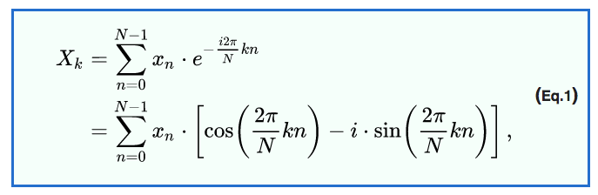
Recap: Frequency analysis with DFT
Continuous Fourier Transform is defined for s[t], t ∈ [-∞, ∞]
Discrete Fourier Transform (DFT) operates for x[n], n ∈ [0, N–1]
Finite bounds for a finite signal.
Windowing helps with spectral leakage.
Fast Fourier Transform (FFT): a computationally effective implementation of DFT.
DFT
(Wikipedia)
Notes:
This could include a visualization with Matlab: rotating vector multiplied by real-valued scalars.

Slide 21
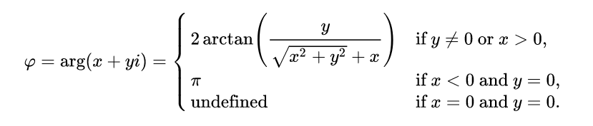
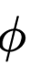
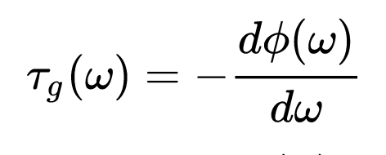
Recap: Frequency analysis with DFT
FFT consists of amplitude and phase information due to complex-valued X(f) = x_{f}+iy_{f}
Magnitude spectrum:
|X(f)| is referred to as linear magnitude spectrum.
Logarithmic magnitude spectrum: 20log₁₀|X(f)|. More convenient due to logarithmic scaling of energy in speech.
Phase spectrum:
Phase depends on signal propagation channel, window position, recording setup (microphone) etc. → often ignored in speech processing.
Group delay: negative derivate of phase w.r.t. frequency:

Slide 22
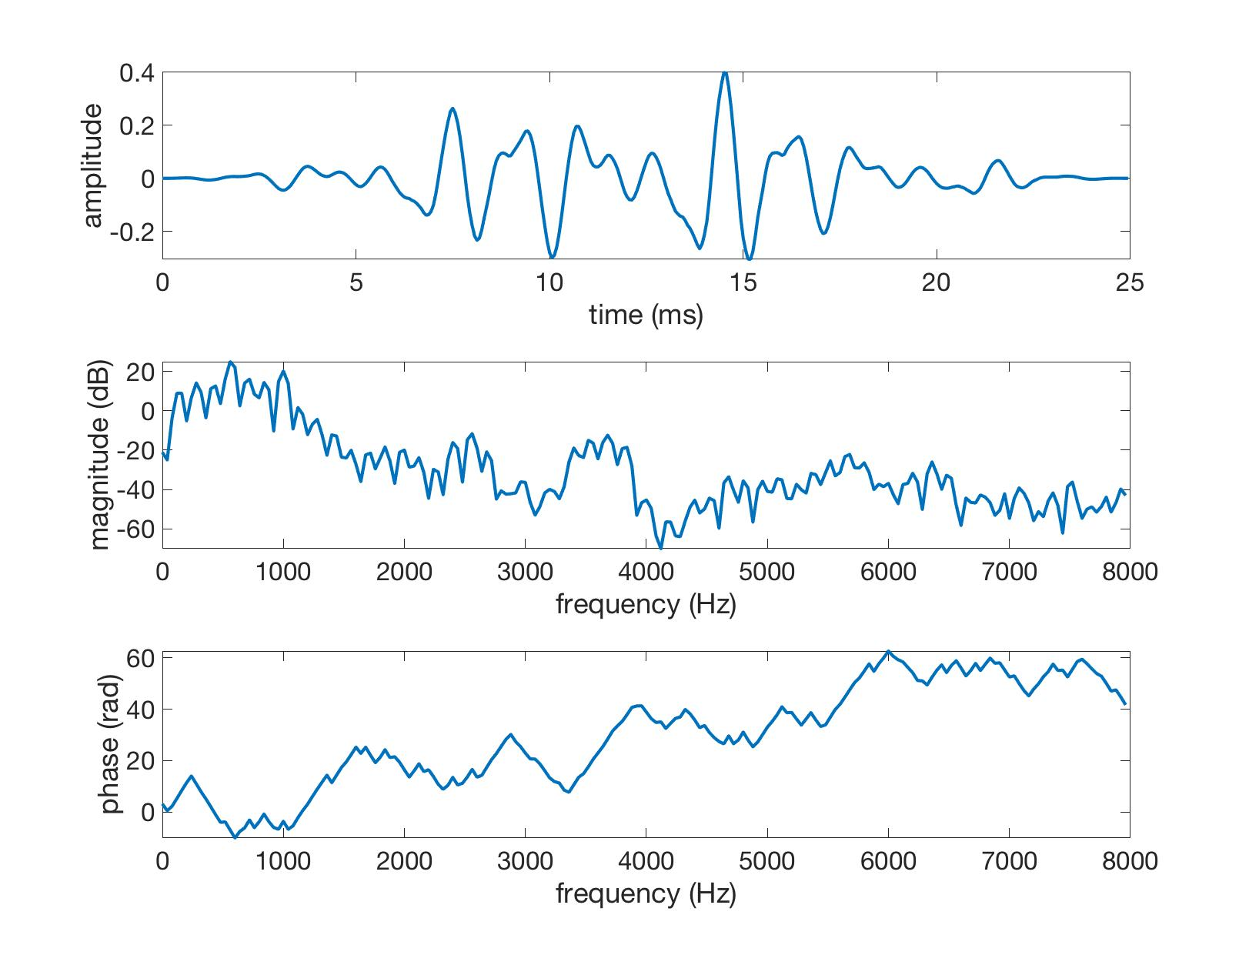
Recap: Frequency analysis with DFT
Speech usually has approx 60 dB dynamics.
~60 dB
Top: windowed signal waveform. Middle: magnitude spectrum of the signal. Bottom: phase spectrum of the signal.

Slide 23
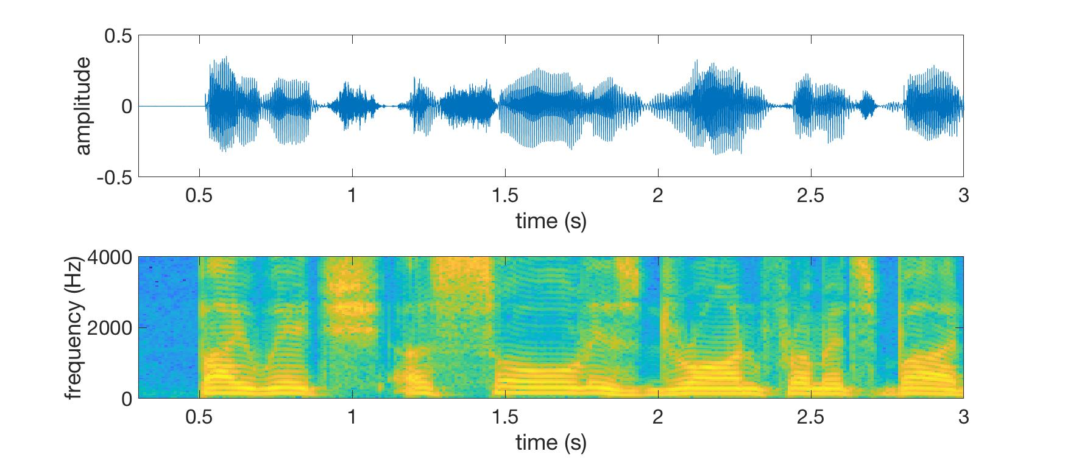
Time-frequency analysis
Normal DFT produces one spectrum X(f). DFT applied to multiple consecutive window positions t is referred to as a spectrogram X(f,t)
Consists of multiple spectral slices (plural: spectra).
Provides a time-frequency representation of the signal.

Slide 24
Mel-spectrograms
Normal FFT spectrum has a uniform frequency resolution across the frequency range.
Human hearing has a higher frequency resolution at lower frequencies.
Speech also contains proportionally more information at lower frequencies.
Mel-spectrogram: a spectrum that mimics the auditory system.
An envelope model: maintains key properties of spectral envelope, discarding details.
Obtained with a mel-filterbank: a bank of triangular filters with logarithmically increasing center frequency and bandwidth.
Approx. linear below 1000 Hz.

Slide 25
Mel-spectrograms
Procedure:
Calculate FFT power spectrum: X(f) = |FFT(x(t))|²
Calculate output of each filter by filtering the FFT spectrum with the Mel-filterbank.
Technically: multiplication in the frequency-domain.
S(band) = X(f) × M(f,band)
→ Mel power spectrum
Entire process can be performed with a single matrix product: S = XM
Take 10log₁₀ of the Mel power spectrum → Logarithmic Mel spectrogram (aka. log-Mel spectrum)

Slide 26
Mel-spectrograms
200 frequency bins
Proportionally less emphasis on high frequencies
loss of F0 and its overtones
40 mel bands

Slide 27
Cepstrum

Slide 28
Cepstrum and quefrency analysis
Cepstrum is homomorphic signal processing:
Transform signal to a domain where linear operations (e.g., standard filtering) can be applied to manipulate non-linear phenomena.

Slide 29
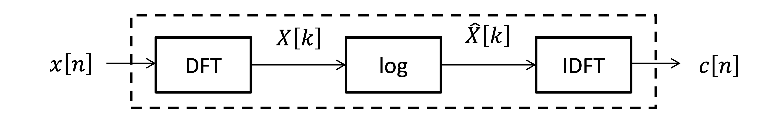
Cepstrum and quefrency analysis
Example: speech excitation g[n] and vocal tract filter v[n] are convolutive in time-domain: x[n] = (g ∗ v)[n]. How to analyze them in linear domain?
Convolution theorem: x[n] = (g ∗ v)[n] = 𝓕⁻¹{𝓕{g[n]∙ 𝓕{v[n]}} = 𝓕⁻¹{G[f]∙V[f]} (multiplication in frequency)
How to make source and tract additive? → logarithm!
x[n] = 𝓕⁻¹{exp(log(G[f]∙V[f]))}= 𝓕⁻¹{exp(log(G[f])+log(V[f]))}
How to apply filters to the additive log-spectra? → Inverse DFT to go to back to “time”!
Complex cepstrum: c[n] = 𝓕⁻¹{log(𝓕{x[n]})}
Power (real) cepstrum: c[n] = |𝓕⁻¹{log(|𝓕{x[n]}|²)}|²

Slide 30
Cepstrum and quefrency analysis
Cepstral cofficients c[n] are in quefrency domain (inverse DFT from logarithmic spectrum does not return to the regular time-domain)
Now n can be interpreted as “delay” instead of sample index in time.
Filtering in the cepstral domain is called liftering.
Convolutive components in x[n] are now additive in c[n].
“Spectrum of a logarithmic spectrum”
Note: all operations are reversible without any loss of information (for the complex cepstrum)

Slide 31
Cepstrum and liftering
We know that F0 < 500 Hz (𝜏₀ > 2 ms). Let’s remove all quefrencies > 2 ms with liftering.
Time-domain
Log-spectrum
cepstrum
low-pass filter stop band
F0
resulting spectrum
liftered cepstrum
Spectrum without F0!

Slide 32
Mel-frequency cepstral coefficients (MFCCs)
MFCCs = cepstral coefficients calculated from log-Mel filterbanks.
Benefits:
Low-dimensional feature representation that maintains key envelope properties of the voal tract.
E.g., log-Mels = 24–40 coefficients, MFCCs: usually 13 coefficients.
MFCCs are mutually decorrelated (better features for classical machine learning)
No need to model covariance of the dimensions: Σ [c_{i},c_{j}], only variance 𝜎²[c_{i}]
Intuitive interpretation: Covariance: How changes in each coefficient affect changes in all other coefficients during a phenomenon of interest (grows exponentially with feature dimensionality) vs. What is the variance of each coefficient during the phenomenon (linear growth with feature dimensionality)

Slide 33
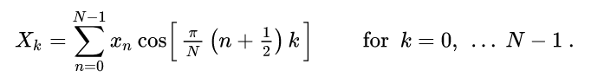
Mel-frequency cepstral coefficients (MFCCs)
MFCC calculation:
Create a mel-filterbank as M(f, j), where f denotes FFT frequency bin and j the corresponding mel-band.
Calculate FFT power spectrum: X(f) = |FFT(x(t))|²
Calculate output of each filter by multiplying the filter response with the spectrum, S(mel) = X(f) × M(f,j)
Convert to log-domain: Y_{db}(j) = 10*log10{S(j)}
Take discrete cosine transform (DCT-II) of the log-Mel spectrogram
Keep the first N coefficients (usually 0–12).
Normal log-mel spectrum
DCT-II:

Slide 34
MFCC cepstrogram
200 frequency bins
correlated dimensions
decorrelated dimensions
(zero-mean & unit variance -normalized for visualization)
13 MFCCs

Slide 35
MFCC interpretation
0th coefficient: signal energy
1st coefficient: spectral tilt
coefficients ~3–5: primary resonances of the vocal tract
(cosine basis upscaled for visualization)

Slide 36
Delta and deltadelta features
The standard approach to short-term analysis (e.g., MFCC extraction): process signal in windows of 20–30 ms using 10-ms steps.
Limitations:
Assumes quasi-stationarity of speech: not generally true.
Does not distinguish direction of change within the window (e.g., decreasing vs. increasing resonance frequencies).
Context not represented (problem for frame-based models).

Slide 37
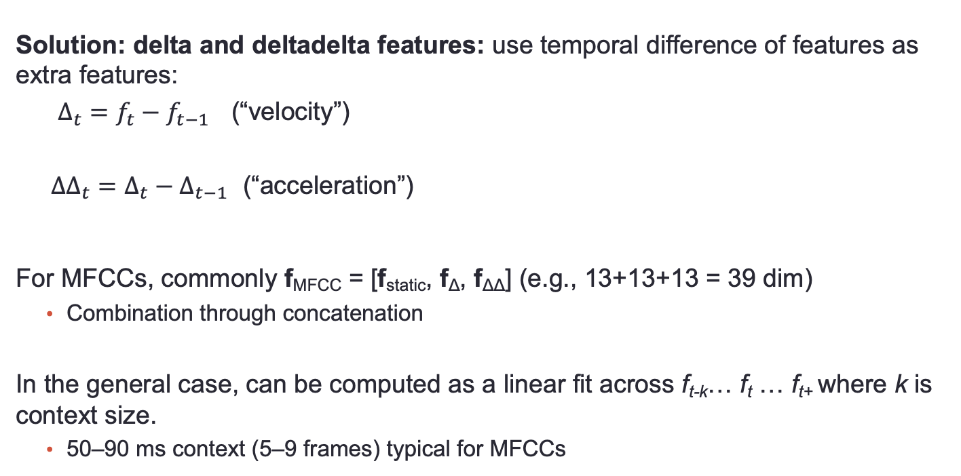
Delta and deltadelta features
Solution: delta and deltadelta features: use temporal difference of features as extra features:
$Δ_{t}=f_{t}−f_{t−1}$ (“velocity”)
${ΔΔ}_{t}=Δ_{t}−Δ_{t−1}$ (“acceleration”)
For MFCCs, commonly f_{MFCC} = [f_{static}, f_{Δ}, f_{ΔΔ}] (e.g., 13+13+13 = 39 dim)
Combination through concatenation
In the general case, can be computed as a linear fit across f_{t-k}… f_{t} … f_{t+} where k is context size.
50–90 ms context (5–9 frames) typical for MFCCs
f
_{t-2}
_{t}
_{t+2}

Slide 38
Pitch-synchronous windowing

Slide 39
Pitch synchronous windowing
Analysis window spanning multiple F0 periods results in comb structure of the spectrum at multiples of F0.
Sometimes difficult to separate vocal tract resonances from F0 peaks.
In pitch-synchronized analysis, the window is positioned on one F0 period.
Ideally: window edges at zero-crossing (= no discontinuity at edges).
Removes F0 from spectrum, but non-trivial to achieve automatically.
Pitch-synchronized window
Regular window

Slide 40
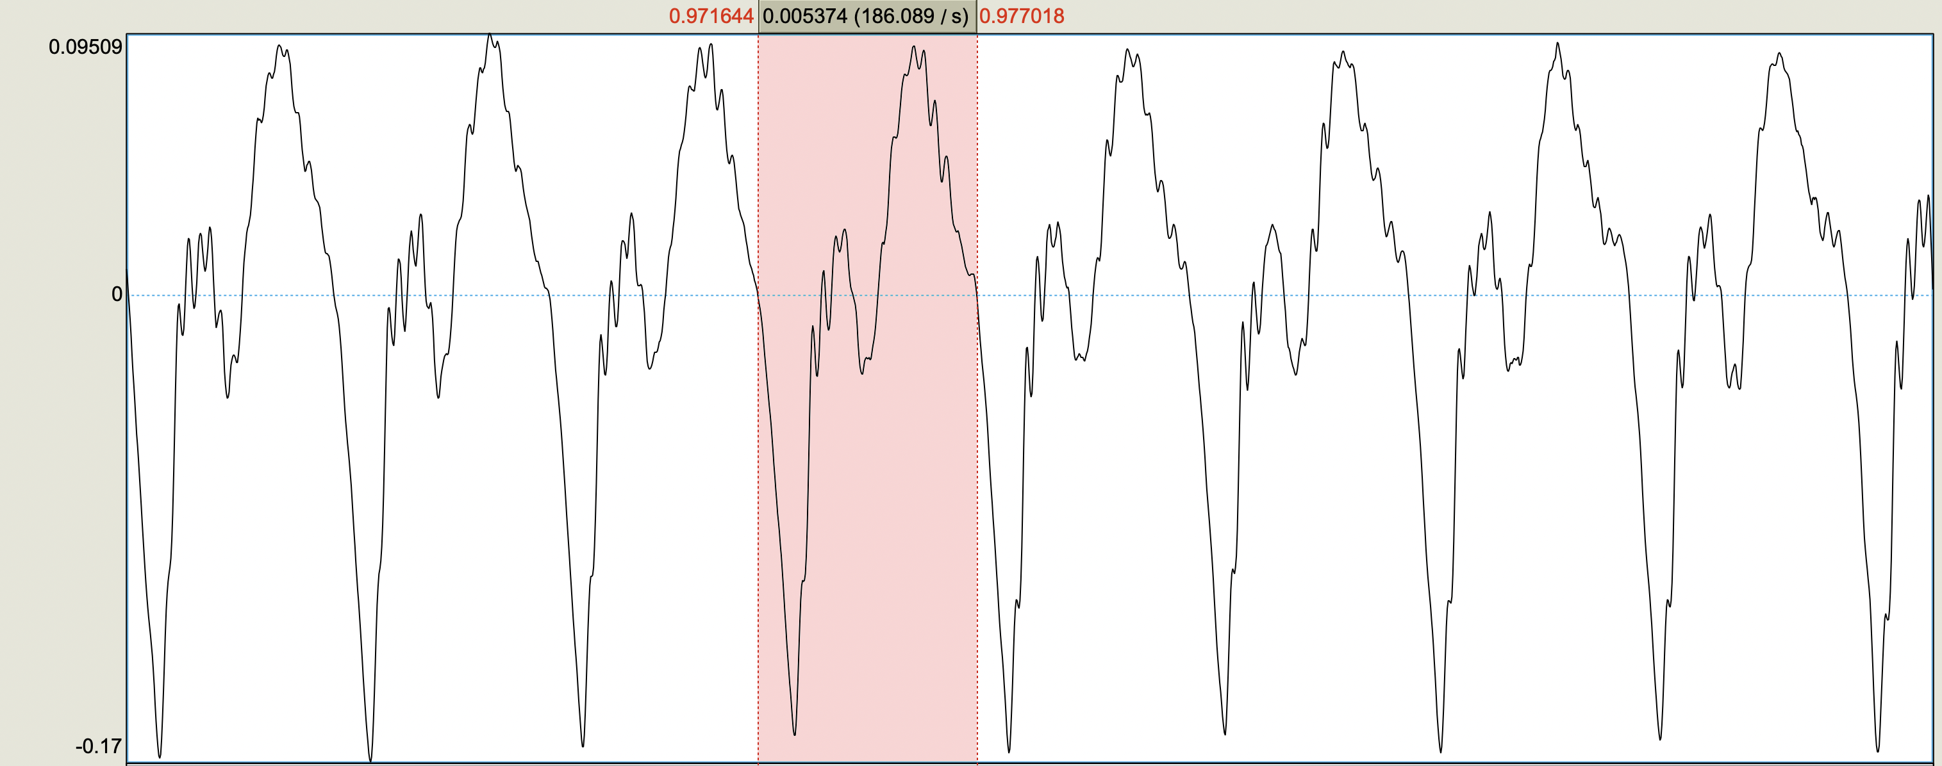
Pitch synchronous windowing: Praat example

Slide 41
Other considerations : speech and noise

Slide 42
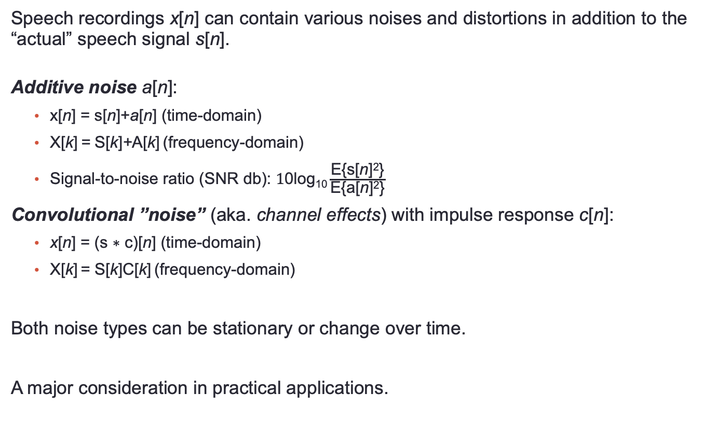
Speech signals and noise
Speech recordings x[n] can contain various noises and distortions in addition to the “actual” speech signal s[n].
Additive noise a[n]:
x[n] = s[n]+a[n] (time-domain)
X[k] = S[k]+A[k] (frequency-domain)
Signal-to-noise ratio (SNR db): $\text{1}\text{0}\text{log}\text{10}\frac{\text{E}\text{\{}\text{s}\text{[}\text{n}\text{]}\text{2}\text{\}}}{\text{E}\text{\{}\text{a}\text{[}\text{n}\text{]}\text{2}\text{\}}}$
Convolutional ”noise” (aka. channel effects) with impulse response c[n]:
x[n] = (s ∗ c)[n] (time-domain)
X[k] = S[k]C[k] (frequency-domain)
Both noise types can be stationary or change over time.
A major consideration in practical applications.

Slide 43
Speech and noise: relevant concepts
Speech enhancement: algorithmic removal of noise from signals.
Signal processing approaches: estimate statistics of the noise + apply corresponding filtering or mathematical operation, e.g:
spectral subtraction
Wiener-filtering
feature normalization
…
Machine learning approaches: model the noise and/or the clean speech. E.g:
estimation of time-frequency (TF) bins with noise (aka. noise masks), then impute the missing TF bins using a model or ignore the bins
estimation of noise properties for DSP filtering
mapping noisy speech to clean speech directly

Slide 44
Speech and noise: relevant concepts
Noise robust processing: methods that work in noisy conditions.
Data noising: controlled addition of noise to speech data (e.g., to test systems in different noise conditions).
Noise augmentation: generation of noisy versions of ML training samples.
Multichannel audio: helps to improve SNR by directional processing.
Audiovisual processing: enhance SNR by seeing speaker’s face (visual articulation).

Slide 45
Example: feature normalization in cepstral domain
Assume a fixed convolutional distortion with an impulse response z[n] (e.g., a specific recording environment/system) and a time-varying speech signal s[n]:
Combined (measured) signal: x[n] = (s ∗ z)[n] (time domain)
Window signal into short-term frames
For each window i:
FFT to get spectrum: X_{i}[f] = S[f]∙Z[f] (convolution theorem)
Cepstrum: c_{i}[n] = s[n]+z[n]
Now: s_{i}[n] depends on speech contents in each i but z_{i}[n] is constant.
Cepstral mean normalization: for each window i, remove the mean of c[n] across all i → removes any constant channel effects from the signal, including z[n]

Slide 46
Summary
Typical speech frequency band used for analysis: 0–8 kHz (f_{s} = 16 kHz).
At a basic level, speech signal consists of noises, short energy bursts, and periodic oscillations.
Windowing enables short-time analysis (usually 20–35 ms windows with 10 ms steps)
Windowing functions help to control spectral leakage (usually Hanning or Haming window)
Some basic time-domain representations: energy, ZCR, autocorrelation.
Time-frequency representations with log-Mel spectra and Mel-frequency cepstral coefficients (MFCCs).
Homomorphic processing with cepstrum: logarithm trick to make convoluted components additive.

